Slide 1
Introduction
Transformer neural networks were first proposed by a Google-led team in 2017 in a widely cited paper titled “Attention Is All You Need”
A transformer neural network can take an input sentence in the form of a sequence of vectors, and converts it into a vector called an encoding, and then decodes it back into another sequence.

Slide 2

Continue
INPUT
OUTPUT
Je suis etudient
I am a student
In a machine translation application, it would take a sentence in one language, and output its translation in another.

Slide 3




Continue
ENCODERS
DECODERS
I am a student
The transformer box contains interconnected encoding and decoding component
Je suis etudient

Slide 4
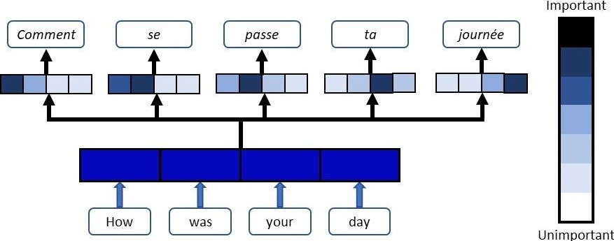
Continue
The Transformer neural network is architecture based on a self-attention mechanism that is mainly designed for language understanding.
During the time of encoding, attention mechanism decides how important other tokens in an inpiut are .
Besides, it allows the transformer to focus on certain words on both the left and right of the current word to decide how to translate it.

Slide 5
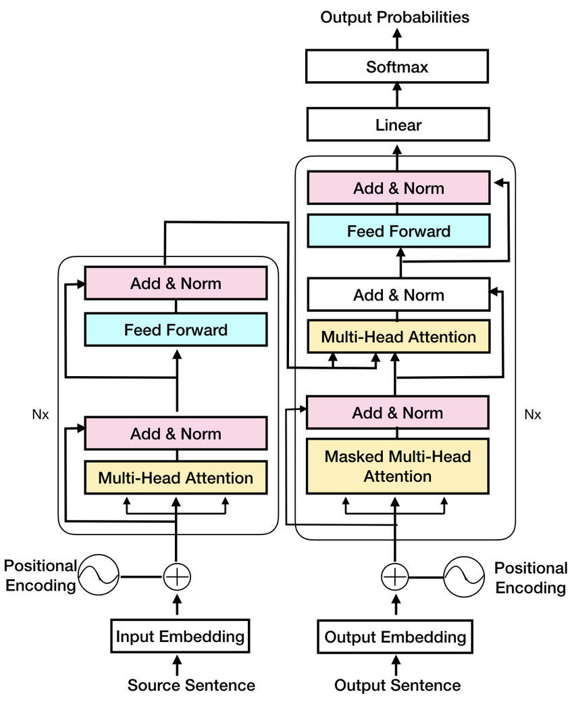
Architecture
ENCODERS
The core architecture consists of a stack of encoders fully connected to a stack of decoders. Each encoder consists of two blocks: a self-attention component, and a feed forward network. Each decoder consists of three blocks: a self-attention component, an encoder-decoder attention component, and a feed forward component.
DECODERS

Slide 6

Architecture
Encoder stack contains six encoder layers on top of each other.
The encoders are all identical in structure (yet they do not share weights). Each one is broken down into two sub-layers:
A multi-head self-attention Layer, and
A position-wise fully connected feed-forward network

Slide 7
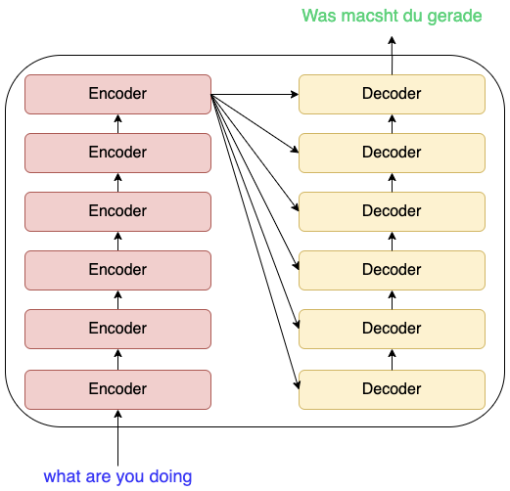
Architecture
The self-attention mechanism takes in a set of input encodings from the previous encoder and weighs their relevance to each other to generate a set of output encodings. The feed-forward neural network then further processes each output encoding individually. These output encodings are finally passed to the next encoder as its input, as well as the decoders.

Slide 8
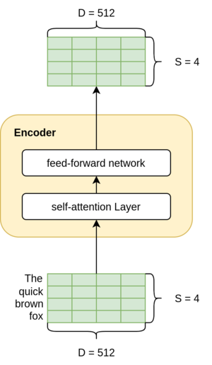
Architecture
Since the encoder layers are stacked on top of each other, the output needs to be of the same dimensions as the input so it can flow easily into the next encoder.
Therefore, the output is also of the shape, SxD.

Slide 9
Architecture
Each decoder consists of three major components:
A self-attention mechanism
An attention mechanism over the encodings and
A feed-forward neural network.
The decoder functions in a similar fashion to the encoder, but an additional attention mechanism is inserted which instead draws relevant information from the encodings generated by the encoders

Slide 10
Self Attention Mechanism in the Transformer
A self-attention module takes in n inputs, and returns n outputs. In layman’s terms, the self-attention mechanism allows the inputs to interact with each other (“self”) and find out who they should pay more attention to (“attention”). The outputs are aggregates of these interactions and attention scores.
The illustrations are divided into the following steps:
Prepare inputs
Initialize weights
Derive key, query and value
Calculate attention scores for Input 1
Calculate softmax
Multiply scores with values
Sum weighted values to get Output 1
Repeat steps 4–7 for Input 2 & Input 3

Slide 11
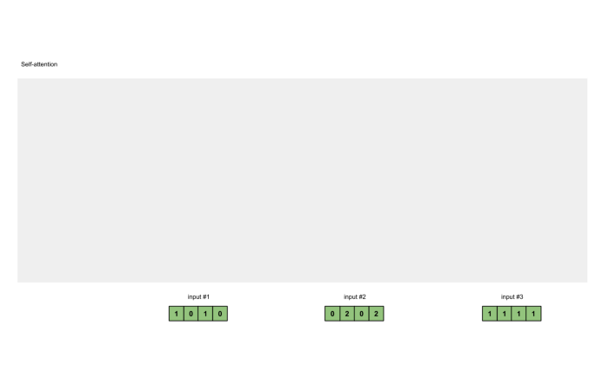
Self Attention Mechanism in the Transformer
Step-1 (Arrange inputs)
Assume we have 3 inputs, each with dimension 4
Input 1: [1, 0, 1, 0] ; Input 2: [0, 2, 0, 2] ; Input 3: [1, 1, 1, 1]
Step-2 (Initialize weights)
Now we have to derive key (orange), query (red), and value (purple). For this example, let’s take that we want these representations to have a dimension of 3. Because every input has a dimension of 4, this means each set of the weights must have a shape of 4×3.

Slide 12
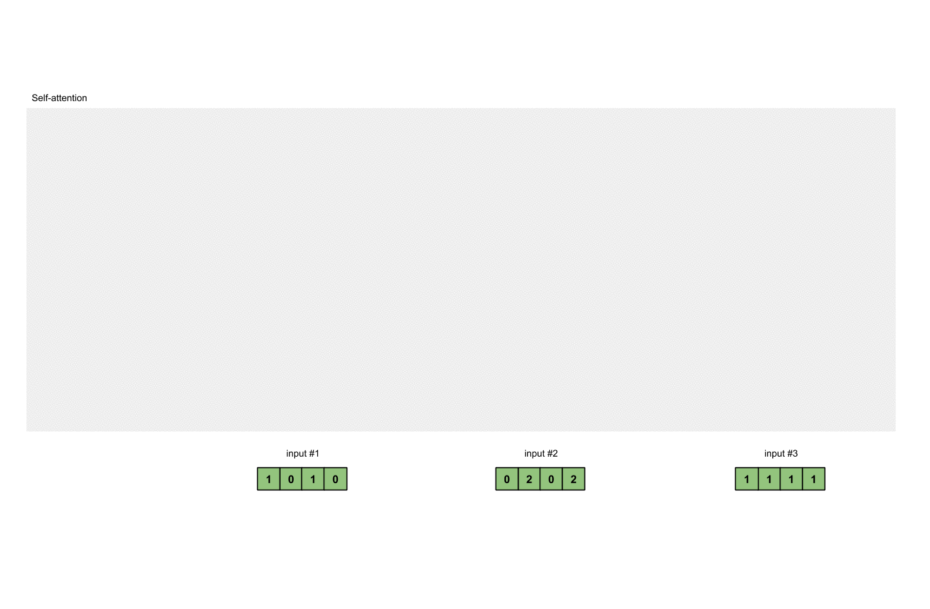
Self Attention Mechanism in the Transformer
In order to obtain these values, every input (green) is multiplied with a set of weights for keys, a set of weights for queries , and a set of weights for values. In our example, we initialize the three sets of weights as follows.
Weights for key: Weights for query: Weights for value:
[[1, 0, 1], [[0, 0, 1], [[0, 2, 0], [1, 0, 0], [1, 1, 0], [0, 3, 0], [0, 0, 1], [0, 1, 0], [1, 0, 3], [0, 1, 1]] [1, 1, 0]] [1, 1, 0]]

Slide 13
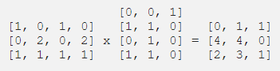
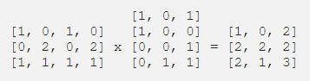
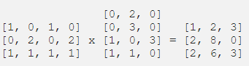
Self Attention Mechanism in the Transformer
Step-3 (Derive key, query and value)
Key outputs for 3 different inputs,K
Query outputs for 3 different inputs,Q
Value outputs for 3 different inputs,V

Slide 14
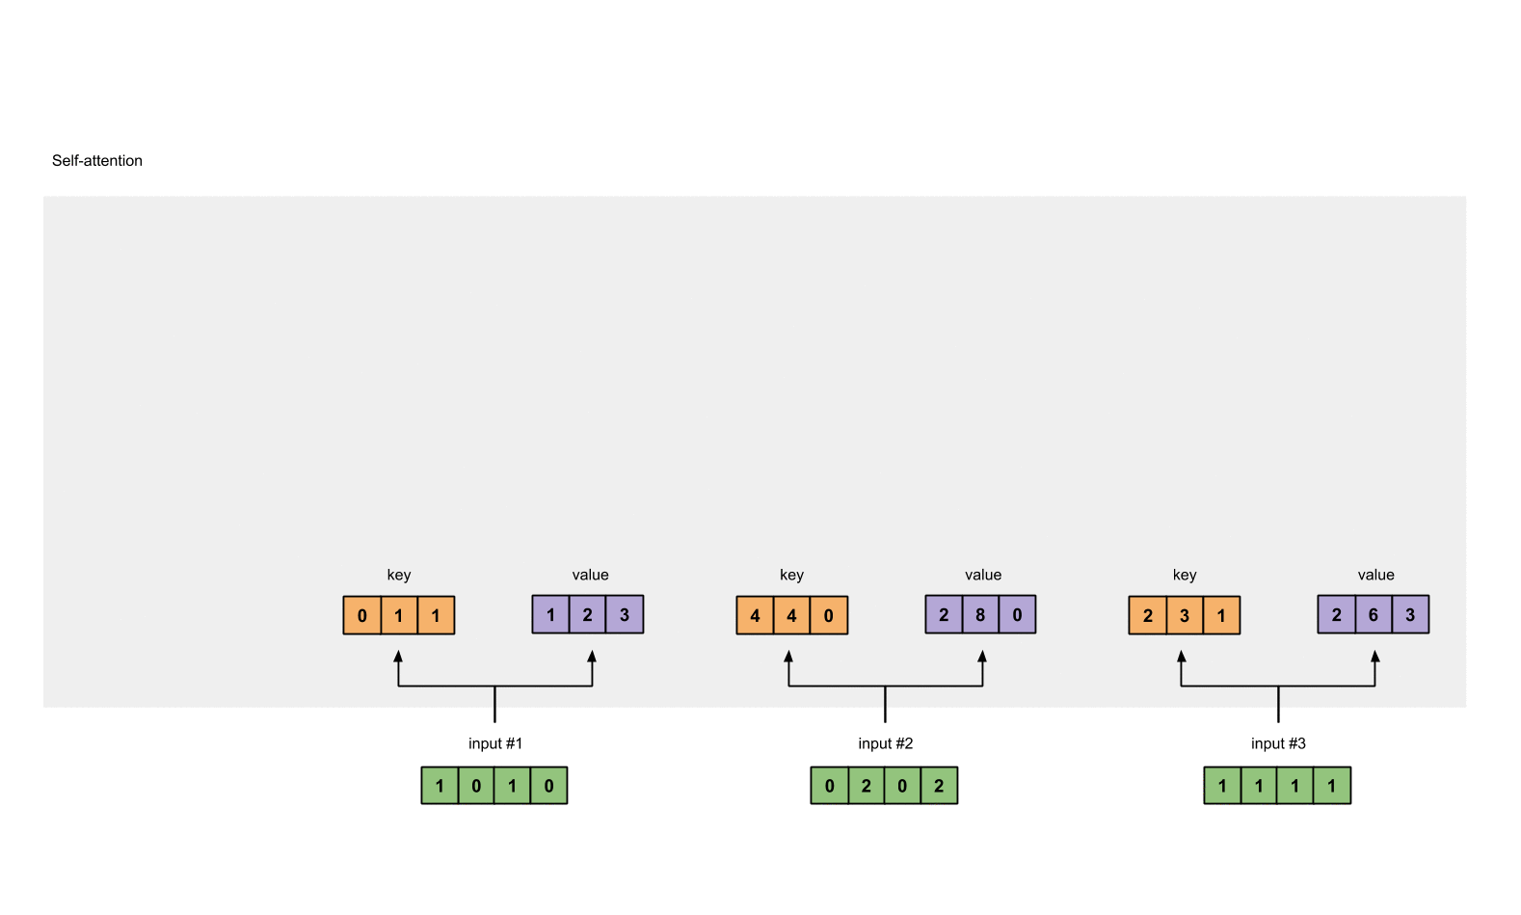
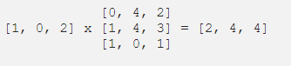
Self Attention Mechanism in the Transformer
Step 4: Calculate attention scores
we start off with taking a dot product between 1st Input’s query (red) with all keys (orange), including itself
Attention Score Matrix
Q.K^{T}

Slide 15

Self Attention Mechanism in the Transformer
Step 5: Calculate softmax
Attention(Q,K,V) =
softmax([2, 4, 4]) = [0.0, 0.5, 0.5]

Slide 16
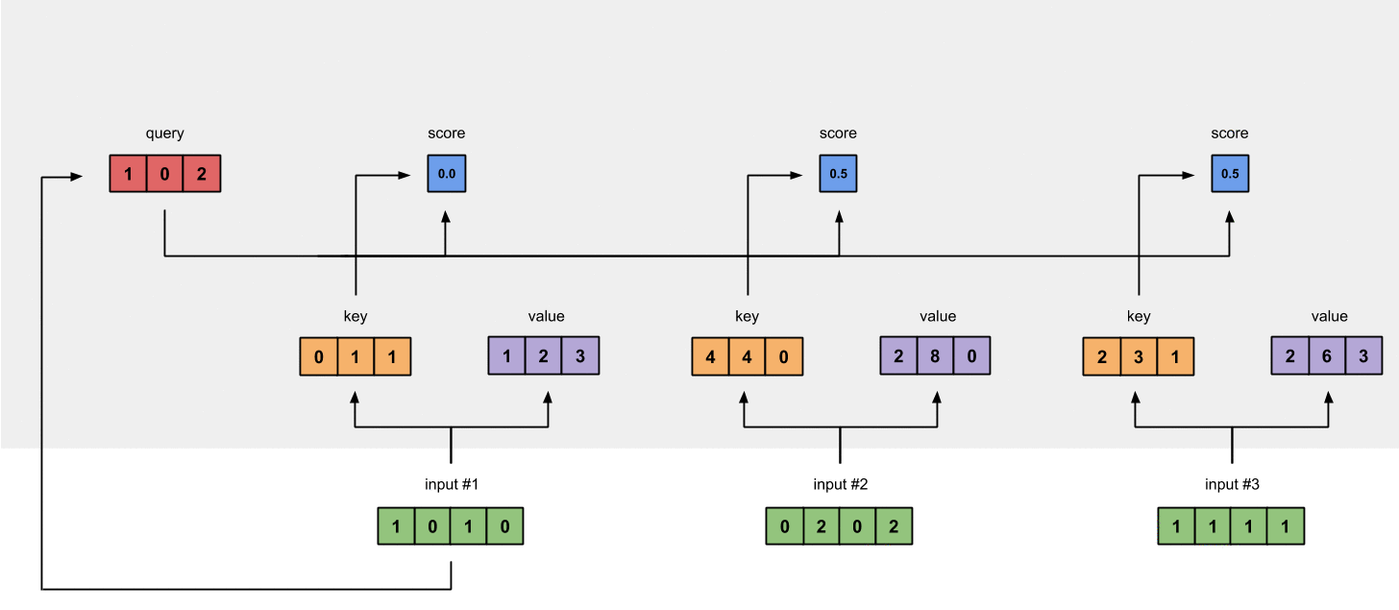
Self Attention Mechanism in the Transformer
Step 6: Multiply scores with values
The softmax attention scores for each input (blue) is multiplied with its corresponding value (purple). This results in 3 alignment vectors (yellow).

Slide 17
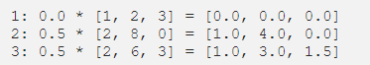
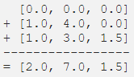
Self Attention Mechanism in the Transformer
Weighted values from step-6
Step 7: Sum weighted values to get Output
The resulting vector [2.0, 7.0, 1.5] is Output 1, which is based on the query representation from Input 1 interacting with all other keys, including itself.
We have to do step-4 to step-7 in the same way to generate output-2 and output-3 from input-1 and input-2

Slide 18
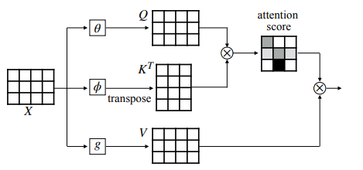
Self Attention Mechanism in a nutshell

Slide 19
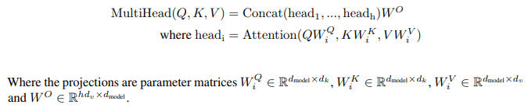
Self-attention sub-layer
The multi-head variant of attention allows the model to jointly attend to information from different representation subspaces, and is defined as
h is the number of heads, and d_{K} and d_{V} are the dimensionalities of Key and Value

Slide 20
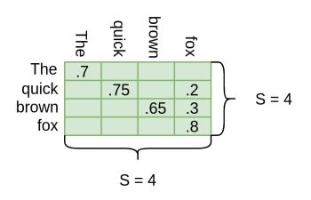
Continue
The self-attention layer is initialized with 3 weight matrices — Query (W^{Q}), Key (W^{k}), and Value (W^{v}). Each of these matrices has a size of (Dxd), where d is taken as 64. The weights for these matrices are trained while training the model.
The resultant would be SxS matrix as the contribution of each word in another word.
Many such self-attention layers when are used in parallel, as a result is called multihead. Input X goes through many self-attention layers in parallel, each of which gives a z matrix of shape (Sxd) = 4×64. Then these 8(h) matrices are concatenated and again a final output linear layer, Wo, of size DxD is applied.

Slide 21
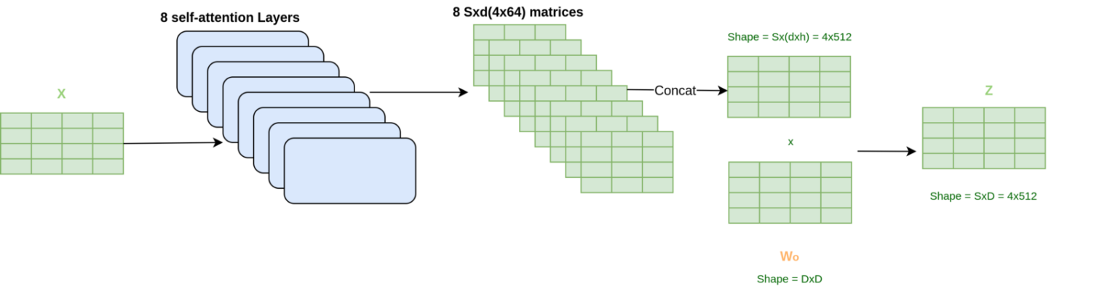
Continue
For concatenation operation a size of SxD(4x(64×8) = 4×512) is found. And multiplying this output by Wo, the final output Z with the shape of SxD(4×512) as desired can be obtained.
Also, the relation between h,d, and D is h x d = D
Finally get the output Z of shape 4×512 is found. But before it goes into another encoder it is passed through a Feed-Forward Network.

Slide 22
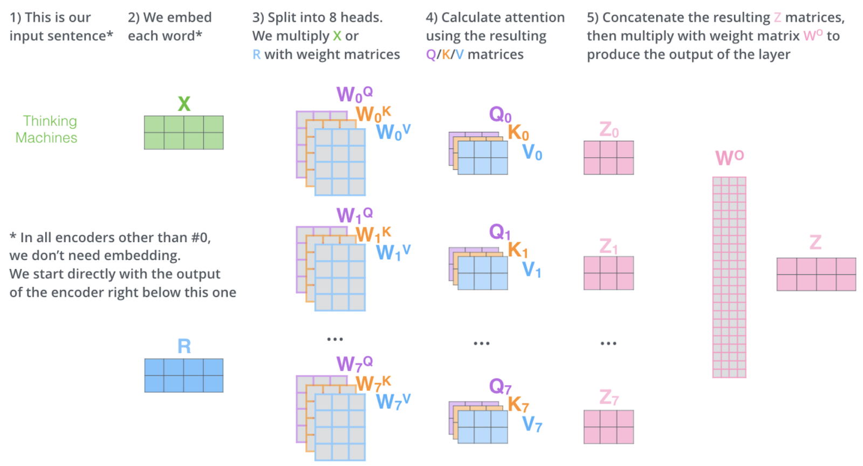
Continue

Slide 23
Position-wise Feed-Forward Networks
.It accepts a 3-dimensional input with shape (batch size, sequence length, feature size). The position-wise FFN consists of two dense layers that applies to the last dimension. Since the same two dense layers are used for each position item in the sequence, we referred to it as position-wise. Indeed, it is equivalent to applying two 1×1 convolution layers.
FFN( h_{i} ) = σ(h_{i}W1 + b1)W2 + b2
Here W1, W2, b1 and b2 are parameters
The self-attention sub-layer takes the information from all positions as input while the position-wise feed-forward layer is applied to each position separately

Slide 24
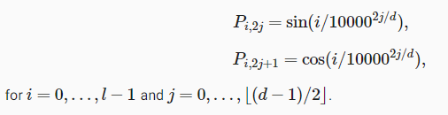
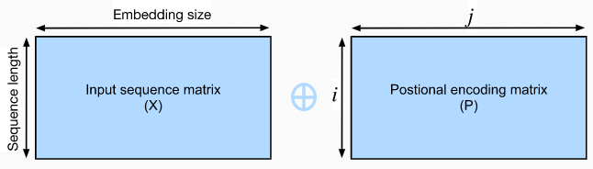
Positional Encoding
To better capture the sequential information, the Transformer model uses the positional encoding to maintain the positional information of the input sequence.
Assume that X ∈ R^{l×d} is the embedding of an example, where l is the sequence length and d is the embedding size. This positional encoding layer encodes X’s position P ∈ R^{l×d} and outputs P + X
The position P is a 2-D matrix, where i refers to the order in the sentence, and j refers to the position along the embedding vector dimension

Slide 25
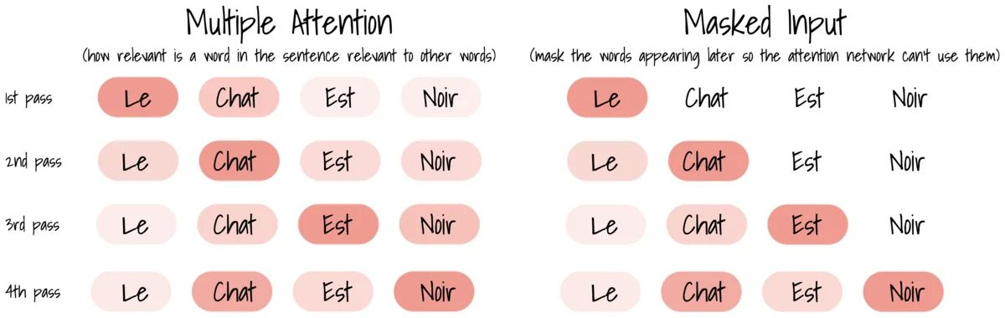
Decoder’s Masked Multi-Head Attention

Slide 26
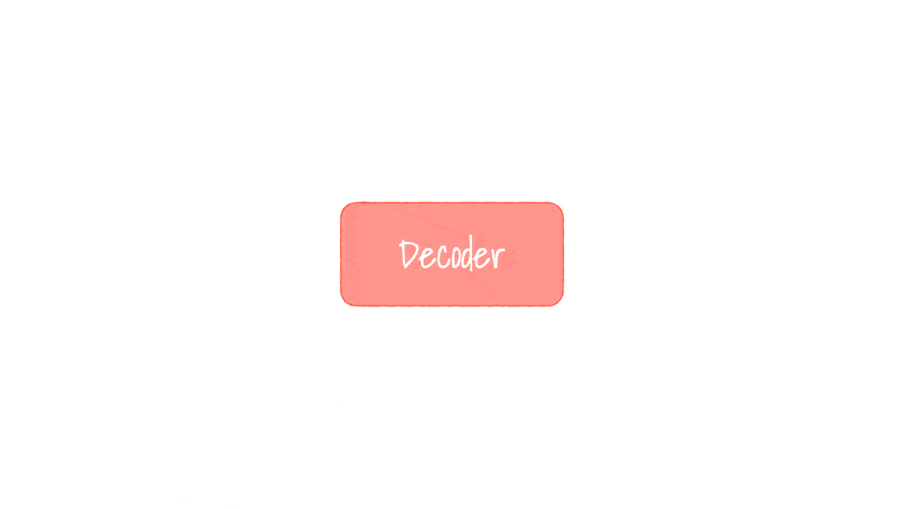
Decoder’s linear layer and softmax
The purpose of the Decoder is to predict the following word, the output size of this feed-forward layer is the number input words in the vocabulary.

Slide 27
The Final Linear and Softmax Layer
The final Linear layer is followed by a Softmax Layer. The decoder stack outputs a vector of floats and the final Linear layer converts those in to words.
The Linear layer is a simple fully connected neural network that projects the vector produced by the stack of decoders, into a much, much larger vector called a logits vector.
If we assume that our model knows 50,000 unique English words that it has learned from its training dataset. This would make the logits vector 50,000 cells wide – each cell corresponding to the score of a unique word. That is how we interpret the output of the model followed by the Linear layer.
The softmax layer then turns those scores into probabilities (all positive, all add up to 1.0). The cell with the highest probability is chosen, and the word associated with it is produced as the output for this time step.

Slide 28
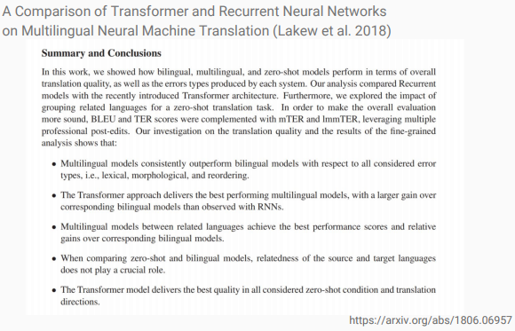
Recent Works
https://arxiv.org/abs/1806.06957

Slide 29
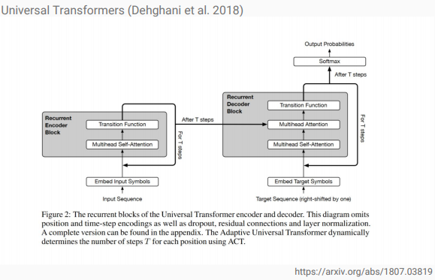
Recent Works
https://arxiv.org/abs/1807.03819

Slide 30
Difference with CNN
The key difference between transformers and convolutional neural networks (CNN), is that transformers can simultaneously attend to every word of their input sequence.
CNNs do not necessarily help with the problem of figuring out the problem of dependencies when translating sentences. That’s why Transformers were created, they are a combination of both CNNs with attention.
CNN starts to look very locally and their receptive field becomes more global in each layer and after quite some training time, whereas Transformer succeeds at having large field of view from the very beginning.
Transformers lack some of the inductive biases inherent to CNNs, such as translation equivariance and locality, and therefore do not generalize well when trained on insufficient amounts of data.

Slide 31
Difference with CNN
For heavy weight state-of-the-art winners, energy consuming, environmental unfriendly, data hungry kind of AI transformer neural network may takeover CNN. However, in case of light weight machine learning in production, for computation and energy economic settings CNN maybe chosen over transformer neural network.
Transformer is very data hungry, it needs huge data to learn how to focus and what to focus it’s attention to make the right predictions.
The given focus pattern can be a limitation in case of CNN, where as due to having large field of view the possibility of making right prediction increases
Transformer overcomes the limitations of CNN’s that look very narrowly at first, limitations which help when there’s not much training data.

Slide 32
Example of Its Usage
Transformer neural networks are useful for many sequence-related deep learning tasks, such as machine translation, text generation, information retrieval, text classification, document summarization, image captioning, and genome analysis.

Slide 33
Transformer in Information Retrieval
Google Search has begun to use Google’s transformer neural network BERT from 2019 for search queries in over 70 languages.
The introduction of transformer neural networks to Google Search means that queries where words such as ‘from’ or ‘to’ affect the meaning are better understood by Google. Users can search in more natural English rather than adapting their search query to what they think Google will understand.
An example from Google’s blog is the query “2019 brazil traveler to USA need a visa.” The position of the word ‘to’ is very important for the correct interpretation of the query. The previous implementation of Google Search was not able to pick up this nuance and returned results about USA citizens traveling to Brazil, whereas the transformer model returns much more relevant pages.

Slide 34
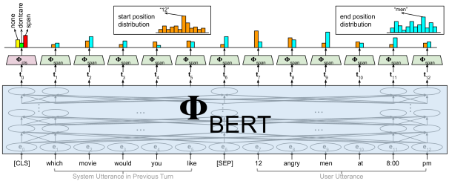
BERT

Slide 35
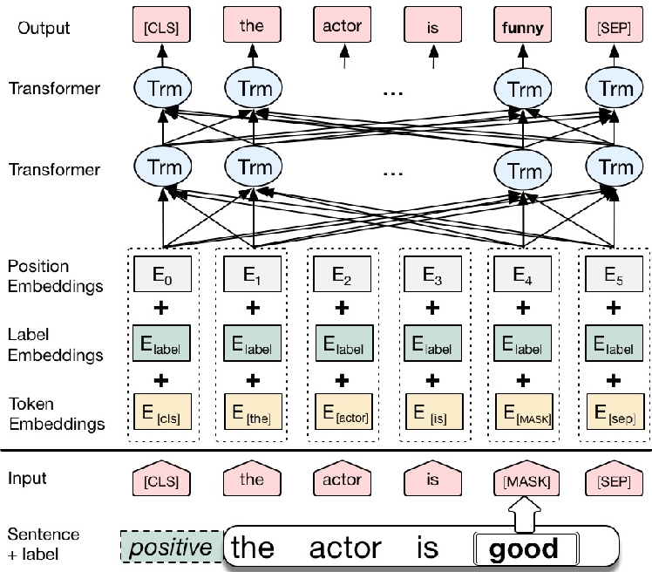
BERT

Slide 36
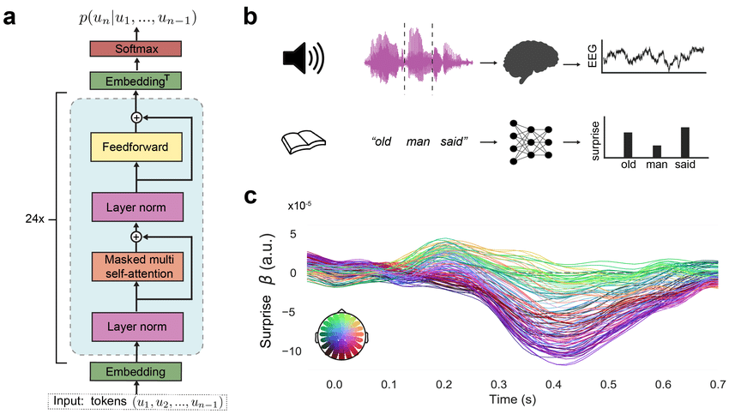
Transformer for Text Generation(GPT)
OpenAI have demonstrated how their transformer models GPT-2 and GPT-3 can generate extremely humanlike texts.
In their paper ‘‘Fine-Tuning Language Models from Human Preferences” , OpenAI introduced reinforcement learning instead of supervised learning to train a transformer neural network to generate text. In this set-up, the transformer
neural network receives a ‘reward’
if it generates a continuation of the
story which is judged pleasing to
human readers.
GPT-2

Slide 37
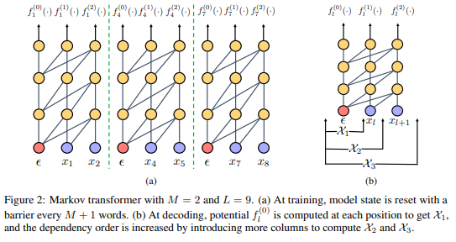
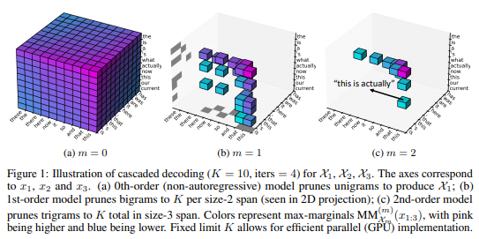
Text Generation(Markov Transformer)
Deng and Rush proposed a probabilistic approach of text generation using Markov Transformer in their paper tittled “Cascaded Text Generation with Markov Transformers”
In this work, they exploit this property by proposing cascaded decoding with a Markov transformer architecture. Their approach centers around a graphical model representation of the output space of text generation.

Slide 38

Thank You for your patience

